Slide 1







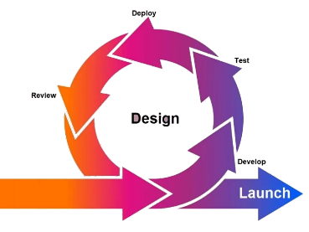

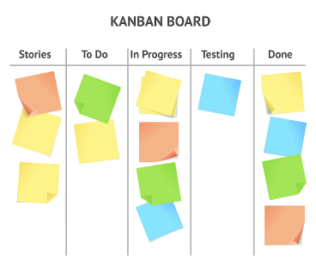


Project
Sustainable Vegetable System
“We are saving the world, one potato at a time.”.
Sasha Stepanov
Bachelor of Information & Communication Technologies Ara - Te Pūkenga, 2023 Sem 2 1989stepania@gmail.com
Learnings
LEARNINGS
- Experience using new tools : Jupiter lab, Matplotlib,Sourcetree
- Knowledge using C# and Python programming languages
- Problem solving skills
- GitHub actions
- Collaboration, communication, meetings, teamwork.
Introduction
The New Zealand government has set strict water quality targets, and to meet these targets farmers have to reduce the amount of fertilizer they use. To solve this problem, Plant and Food Research is creating a tool that would help to solve this problem.
The created model requires refinement and testing to meet the specified requirements and accuracy of fertilizer calculations.
Tools Used
Aim
Industrial
The project for the PFR (Plant and Food Research) company is aimed at improving the environmental situation in the country.
The main outline of the project for the industry is a tested and working model for calculating the correct amount of Nitrogen fertiliser required at a given time.
Refactor and test a model that can be used in the future by farmers.
Help improve N management and reduce N leaching for improved production and environmental sustainability.
Integrated testing using GitHub pull
request process.
Enlightenment of farmers in the rational and
correct use of nitrogen fertilisers.
Professional
Experience in managing and working on an IT project.
Using acquired professional skills in ICT
Obtaining new skills, both professional and soft.
Outcomes
There will be very smart information about the results of the project, and there will also be examples, at least two for sure.
Conclusion
Method
Skills were gained in using the Agile methodology and Kanban board in a real project.
Used acquired project management skills such as time management, risk assessment, quality assessment.
The project completed by the student will be used by a modeling team of PFR in the future.
The student gained irreplaceable experience working in a scientific center.
The project was divided into 5 main phases, which allowed for continuous improvement, and helped to identify problems early and act. Agile was a development methodology that, in combination with Kanban, helped achieve the desired result.
Reference
Acknowledgements
Course Convenor: Dr David Weir
Academic Supervisor : Dr Luofeng Xue
Industrial Supervisor : Dr Hamish Brown

